Slide 1


Analyzing Standing Accretion Shock Instability using Gravitational Waves
Miriam Biehle
Mentor: Dr. Michele Zanolin
College of Arts and Sciences - Space Physics

Slide 2





Acknowledgements
Kya Schluterman
Micheal Benjamin
Colter Richardson
Abhinav Rijal
Marek Szczepańczyk
Dr. Soma Mukherjee

Slide 3
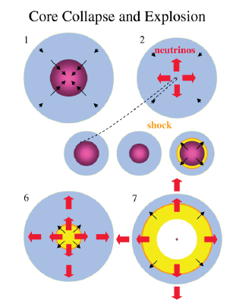
Representation of a Core Collapse
Super Massive Star
Fusion Occurs at the Center
Collapse to produce a Proto-Neutron Star
Shock front propagating through the star.

Slide 4
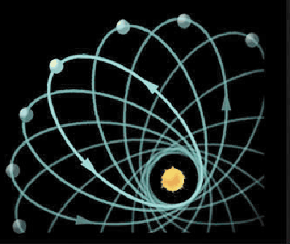
The Shock Front Can Stall and Start Precessing Around the Proto-Neutron Star.
Precession of Shock Front is 360 degrees every 10 miliseconds
SASI-Distorted
Shock
Neutrino-Driven
Convection
Proto-
Neutrino
Star
Gain
Radius
Standing Accretion Shock Instability (SASI)
Heating Region
Cooling Region
Precession of Mercury
Precession of Mercury is 5600 seconds of arc per century

Slide 5
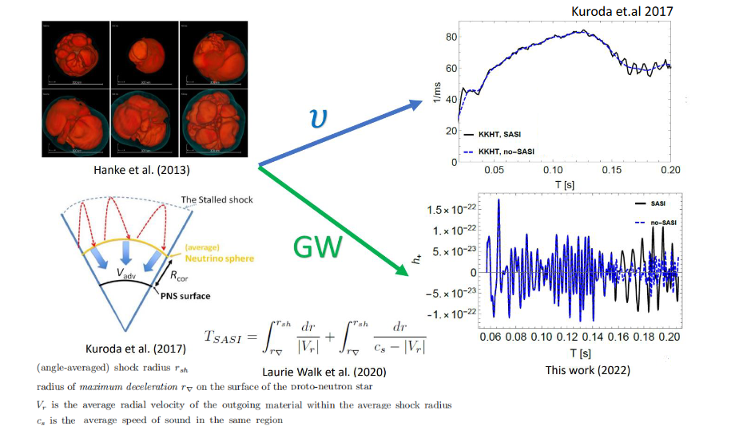
Goal: Study the Precession of Standing Accretion Shock Instability (SASI) with Neutrinos and Gravitational Wave Observation

Slide 6
Spectrogram Representation of Gravitational Wave
SASI Component

Slide 7
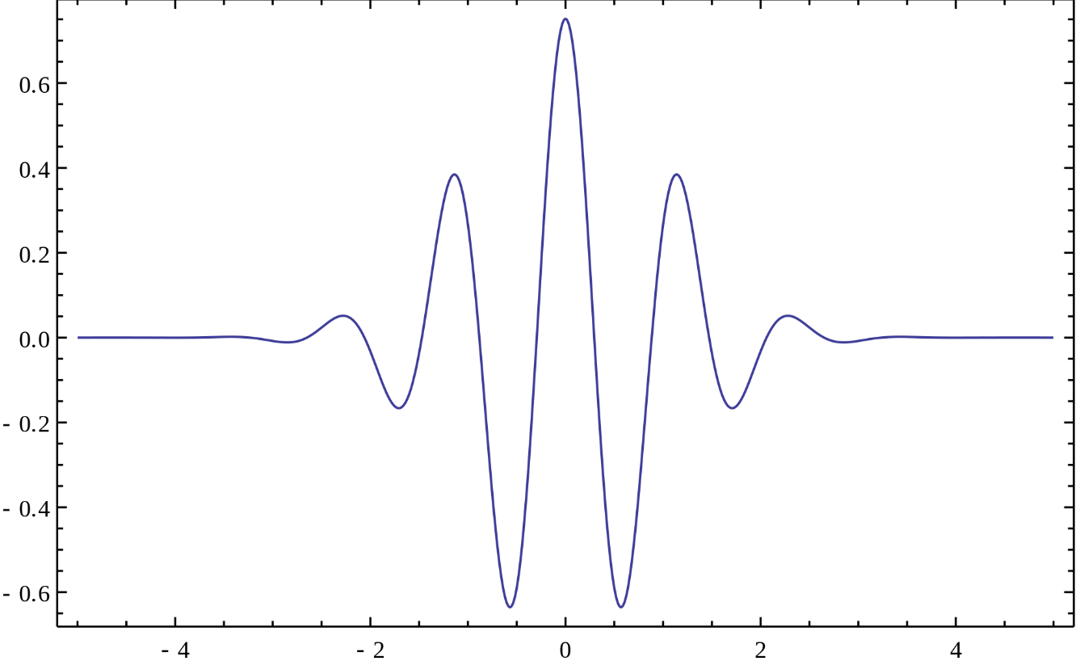


Wavelets
Wavelet decomposition of a time-series allows to assign a magnitude to the energy located in specific time-frequency region.
This energy can be visualized with a color map corresponding to the magnitude of the dot product between the time-series and the wavelet.
b controls the time location of the wavelet
a controls the frequency of interest of the wavelet

Slide 8
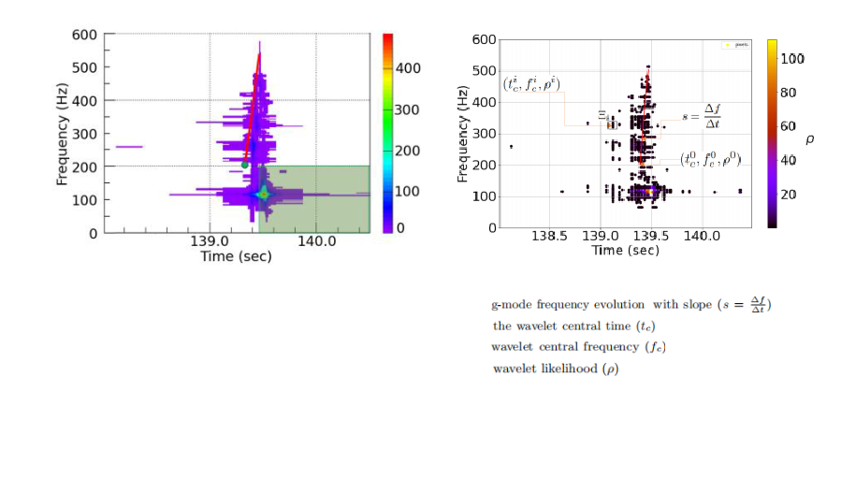

cWB Representation of Gravitational Wave
SASI Box

Slide 9
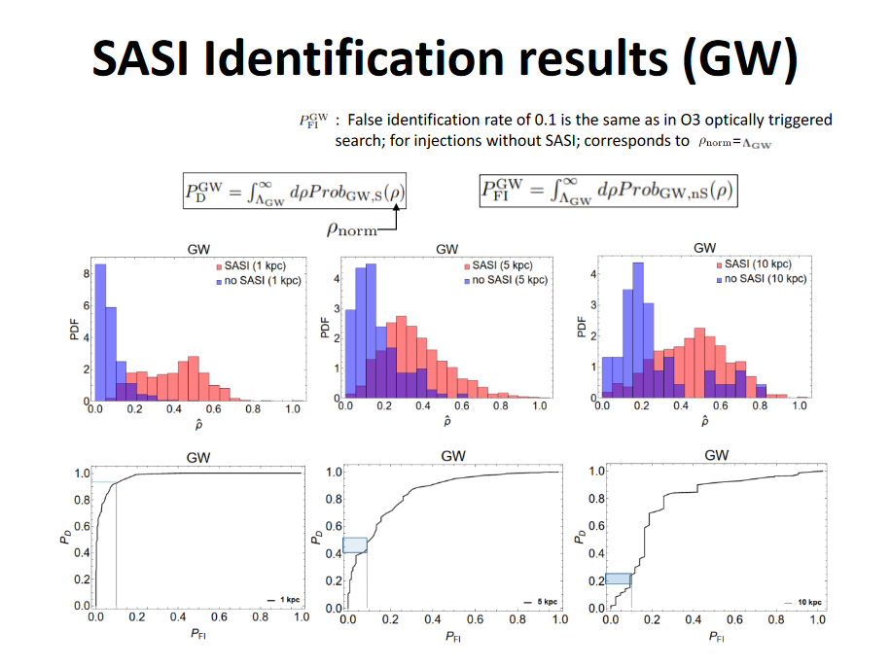

Slide 10
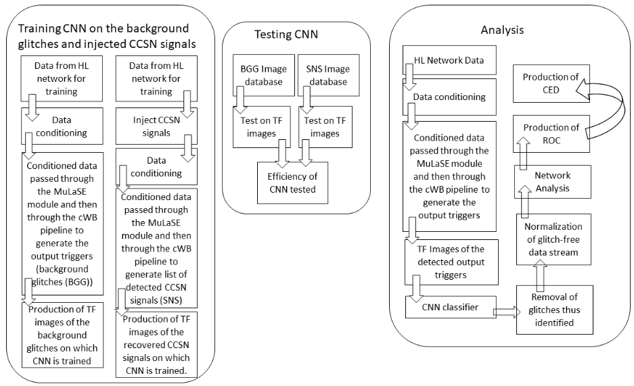
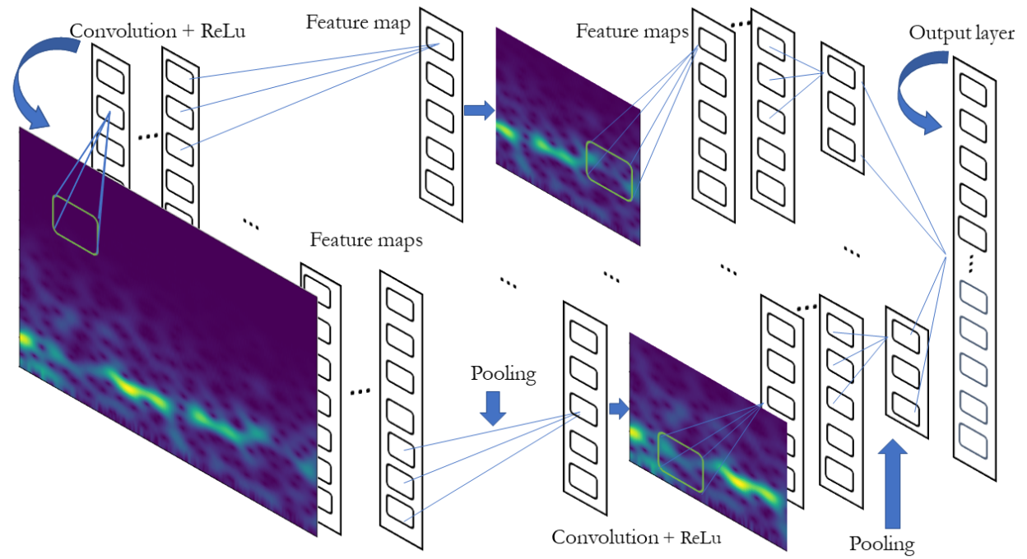
MuLaSECc
Mukherjee, S., Nurbek, G., & Valdez, O. (2021). Study of efficient methods of detection and reconstruction of gravitational waves from nonrotating 3D general relativistic core collapse supernovae explosion using multilayer signal estimation method. American Physical Society (APS). https://doi.org/10.1103/physrevd.103.103008

Slide 11
Project Approach
Inject gravitational wave data into laser interferometric data
Produce curves of probability of identifying the presence of the SASI
Produce scalograms of the reconstructed events
Estimate duration and frequency related to distance from Earth
Produce probabilities that the cWB constructed events contain SASI
Produce Time-series of gravitational waves

Slide 12
What are we Solving?
To Improve Range of Detection to 10kpc
Detect SASI Through Gravitational Waves
Improving current analytical processes
Increase Signal to Noise Ratio (SNR)
Using cWB pipelines to implement more efficient detection strategies
Combining and improving the work of cWB, MuLaSECc, and SASImeter

